Slide 1
WEB DESIGN PROJECT FLIXON
Presented by :-
Shubhi Sharma
Krutika Kothawale
Yash Khopkar
Jhalak Gupta

Slide 2
OBJECTIVE
Flixon is a review aggregator application for movies, music and games.
It is designed to showcase technologies like HTML5, CSS3, Bootstrap4, JavaScript, JQuery.
It is designed to empower your decision to choose your source of entertainment wisely.

Slide 3
SCOPE
Movies – Includes trailers, reviews and list of movies.
Games – Includes videos, reviews and list of games.
Music – Includes audios which can be downloaded, reviews, details and list of songs.

Slide 4
Technical Implementations
YouTube API
Iframe
Video Controls
Audio Controls
Share via Watsapp
Share via Email
Calendar
Bootstrap4
HTML5
CSS3
JavaScript
JQuery
PHP
Chatbot

Slide 5
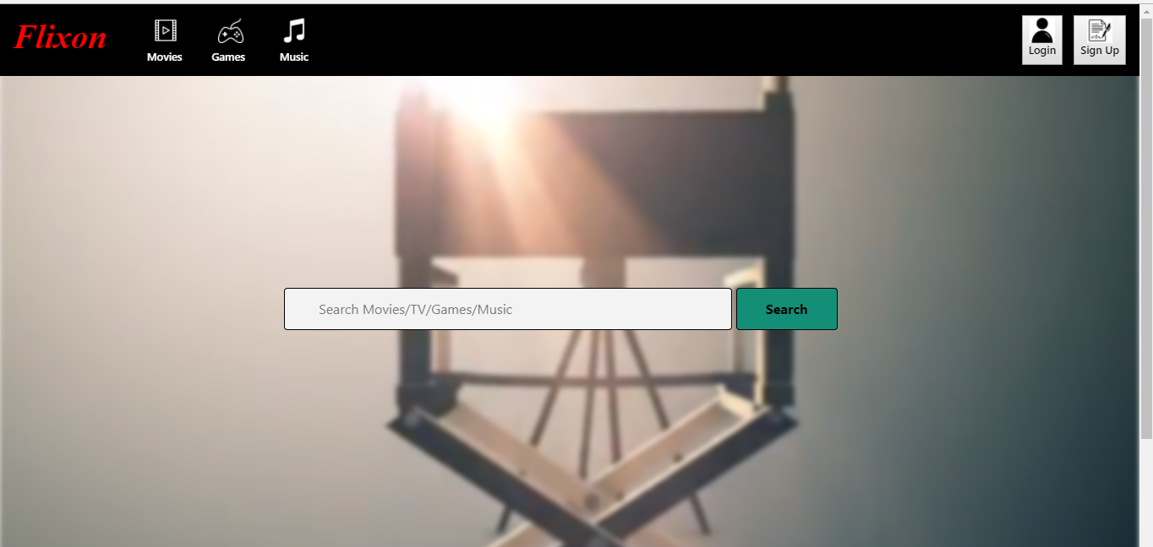
Home Screen

Slide 6
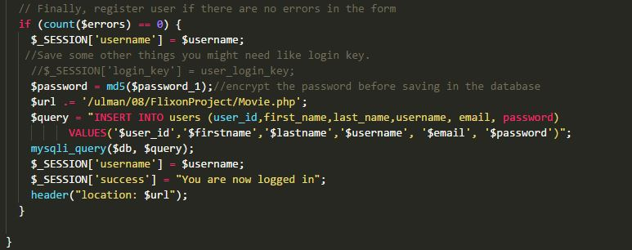
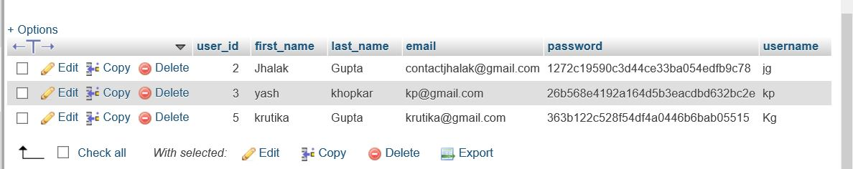
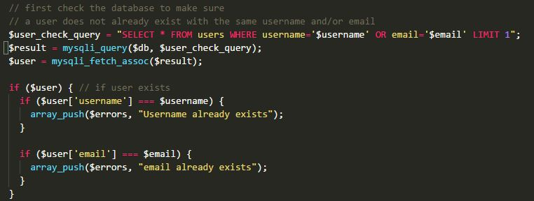
AUTHENTICATION

Slide 7
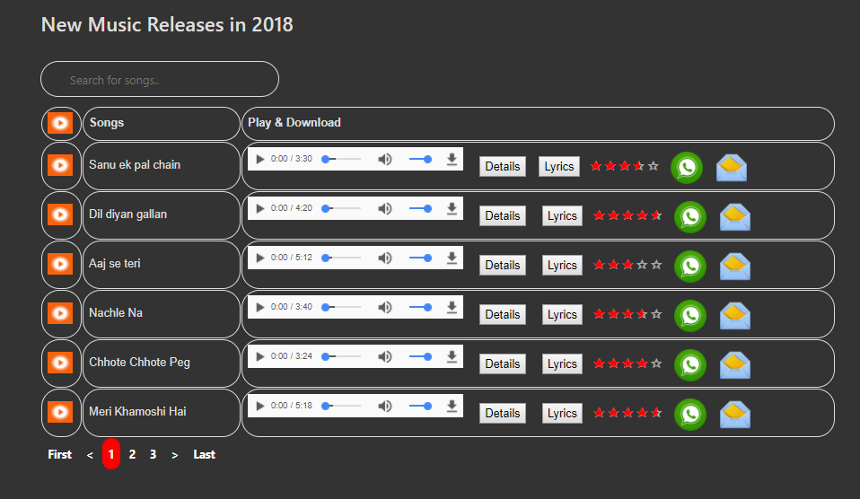
Music Screen

Slide 8
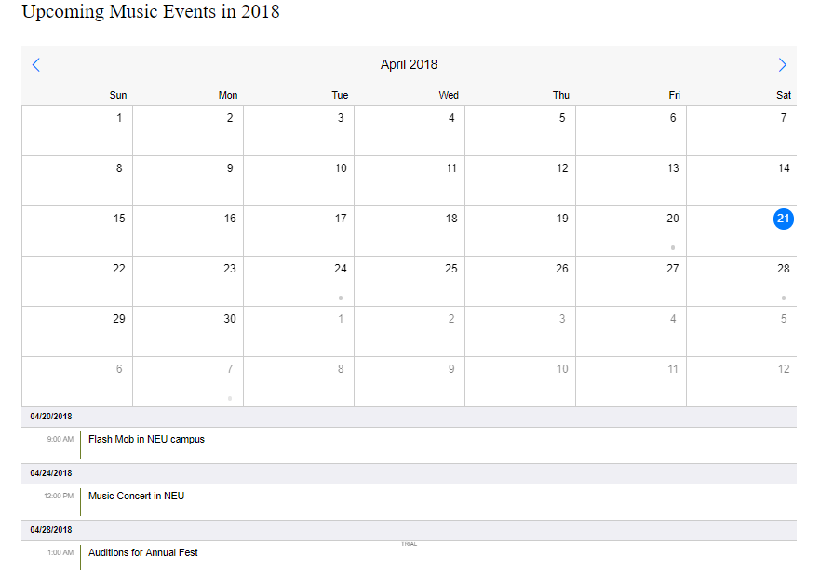
Music Screen

Slide 9
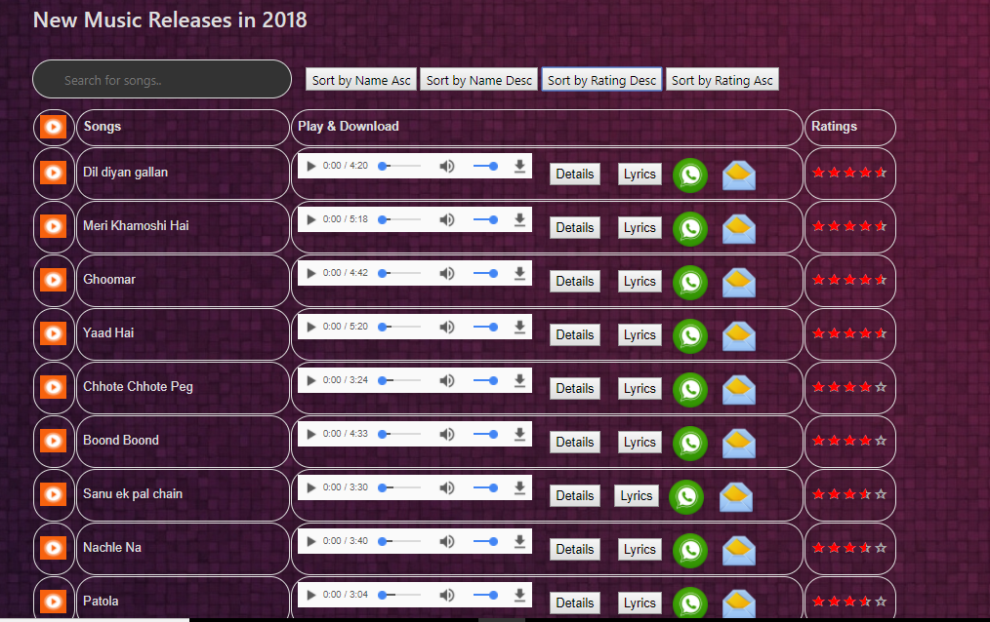
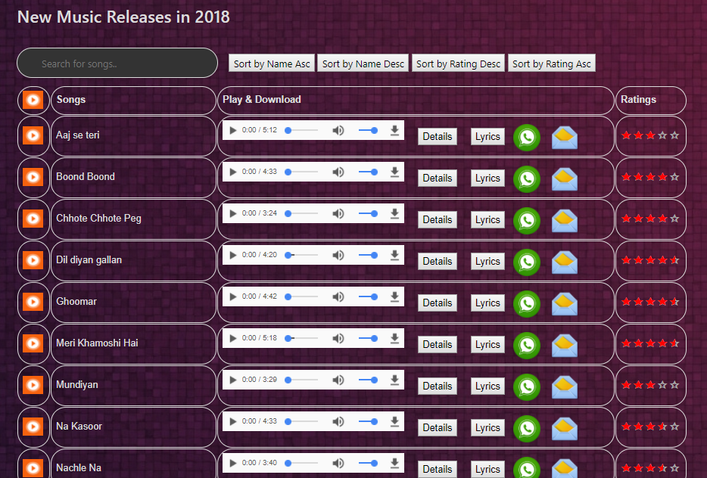
Music Screen

Slide 10
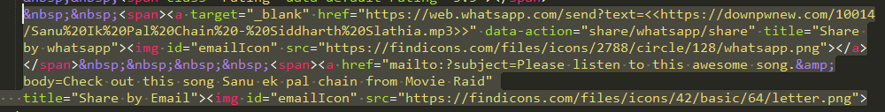
Music Screen Code Snippet for WhatsApp share

Slide 11
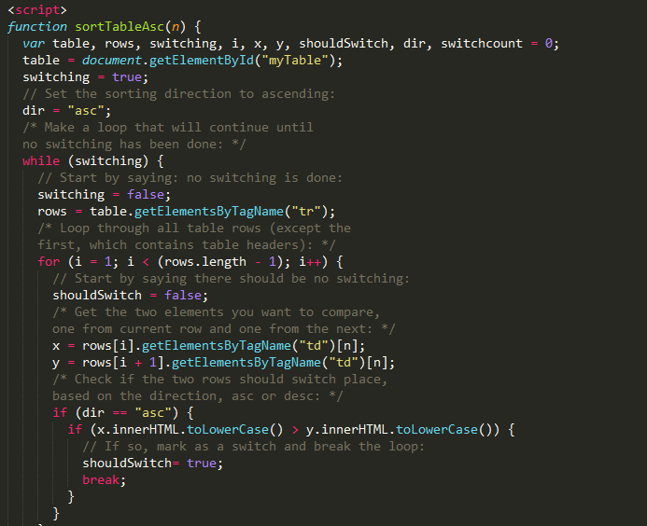
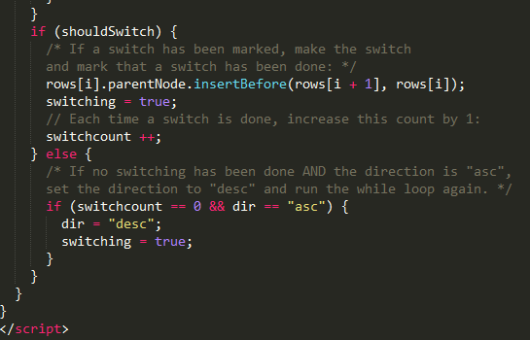
Music Scree Code Snippet for Sorting

Slide 12
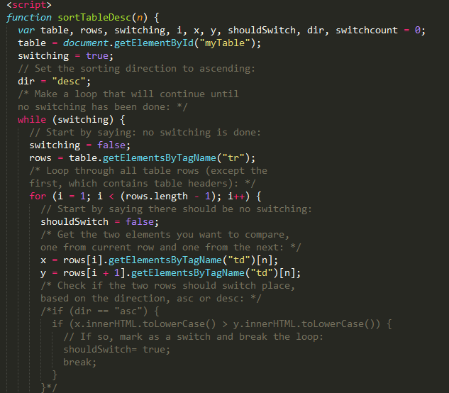
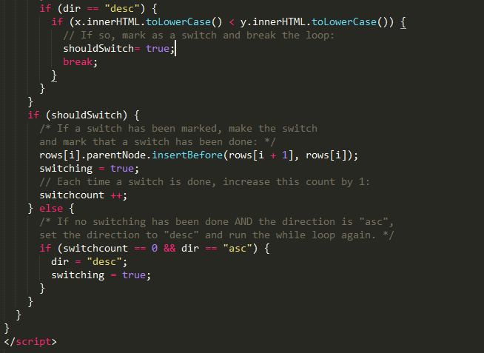
Music Screen Code Snippet for Sorting

Slide 13
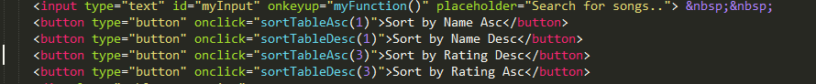
Music Screen Code Snippet for Sorting

Slide 14
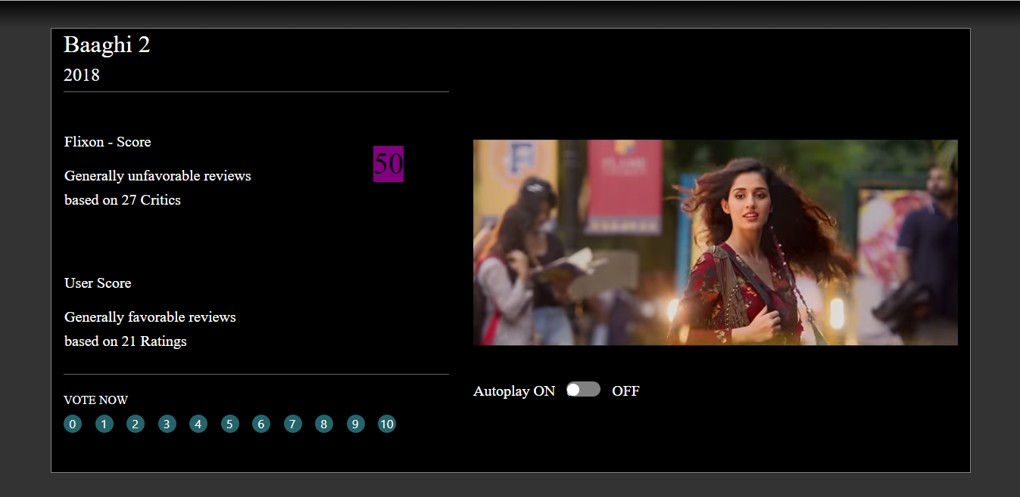
Movie Screen

Slide 15
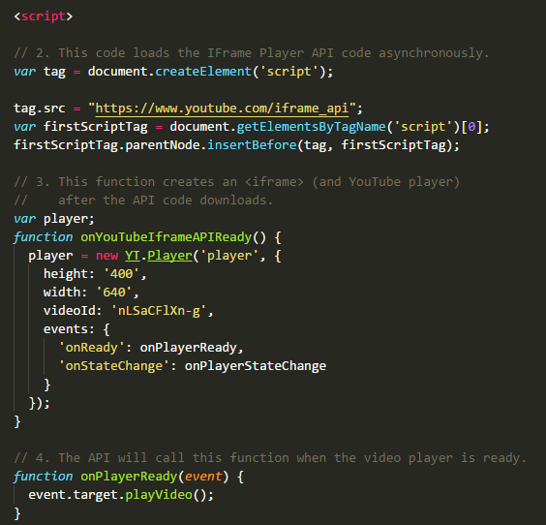
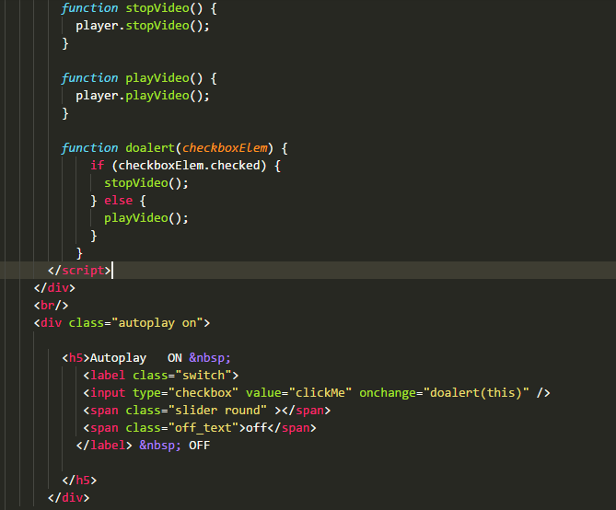
Code Snippet for Video

Slide 16
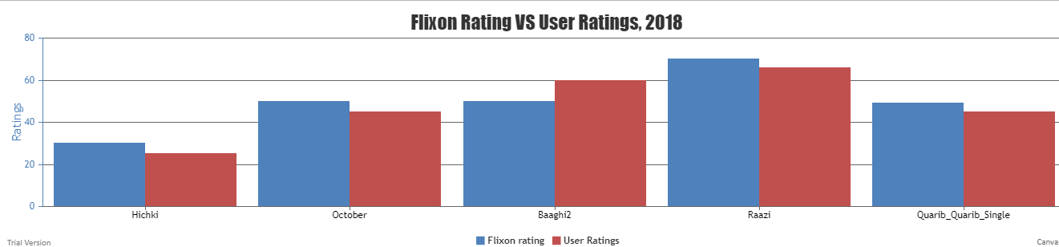
Chart Flixon VS User Ratings

Slide 17
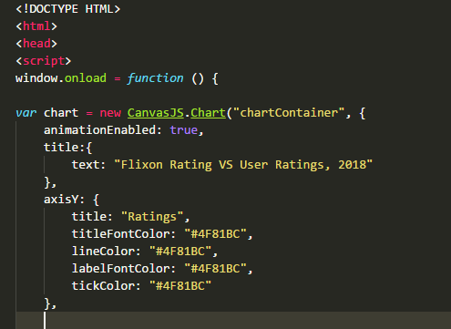
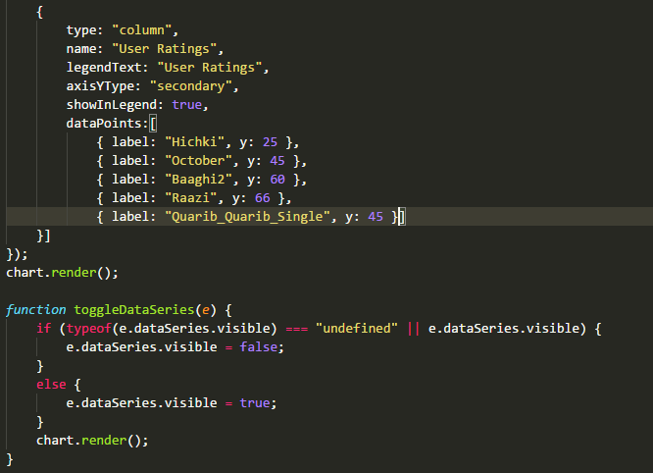
Chart Code Snippet

Slide 18
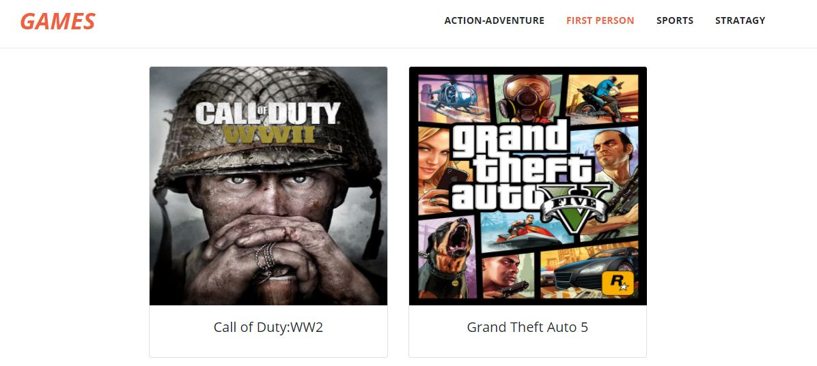

Games Screen

Slide 19
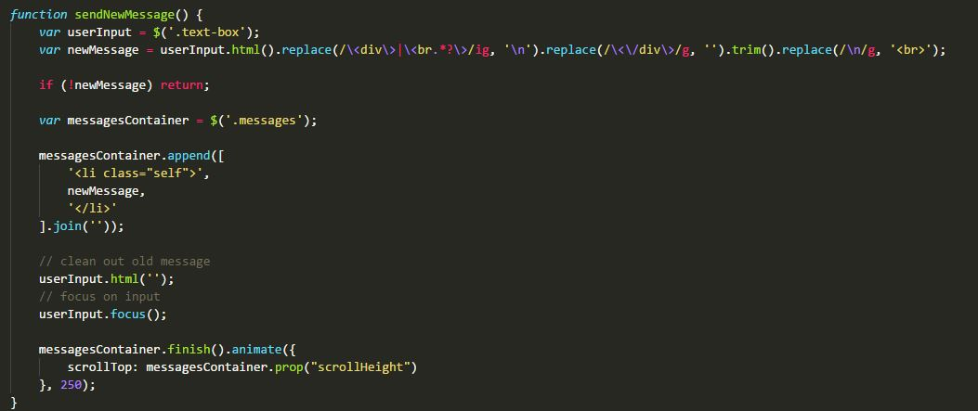
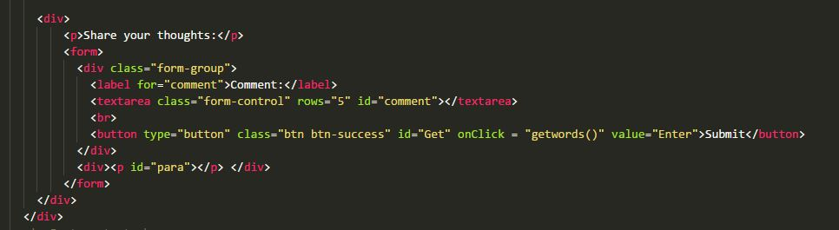
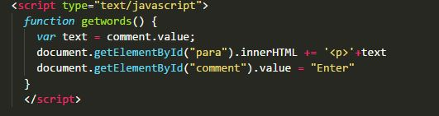
Games Snippet

Slide 20


